Slide 1
Monash DA Bootcamp-Project 1
Melbourne Real Estate Industry Analysis
Present By
Echo Yu, Rachel Zhang, Anjali Khare, Therese Reed

Slide 2
Motivation & Summary

Slide 3

Our Project’s Motivation
Real estate industry is very close to our life
House price change during 2019-2021
A lot of the news related to real estate industry lately(stamp duty, capital gain tax, deposit drop)
Amazon’s data is soooooo hard to find

Slide 4



Questions
Does Covid-19 has impact on real estate industry?
Dose Bank Interests has impact on real estate industry?
Do School numbers and ranking have impact on real estate industry?

Slide 5

Hypothesis
Covid-19
1.Null Hypothesis - If there was no covid then the sales number and price of property would be high
2.Alternative Hypothesis - If there is covid the sales number and price of property would be low
Bank Interests
1.Null Hypothesis - If the bank interests is drop and then the sell price of the property will go high
2.Alternative Hypothesis - If the bank interests is drop and then the rent of the property will go low
School Ranking/Number of Schools
1.Null Hypothesis - If the school ranking is not high then sales the price of property will go low
2.Alternative Hypothesis - If the school ranking is high then then sales the price of property will be high

Slide 6


Our Analysis-Fundamental
Fundamental Analysis
Yearly Data ---> Not much of the difference, THERE EVEN AN CONTINUOUS INCREASE!!
Quarterly Data ---> There is a drop in 2nd quarter of 2020, and then it gradually picked up, and even had some increases.
MedianSoldPrice, AuctionNumberAuctioned, AuctionNumberSold, AuctionNumberWithdrawn, NumberSold, LowestSoldPrice, HighestSoldPrice, 5thPercentileSoldPrice, 25thPercentileSoldPrice, 75thPercentileSoldPrice, 95thPercentileSoldPrice, DaysOnMarket, DiscountPercentage, MedianRentListingPrice, NumberRentListing, HighestRentListingPrice, LowestRentListingPrice, MedianSaleListingPrice, NumberSaleListing, HighestSaleListingPrice, LowestSaleListingPrice
Chart Created
Yearly Data ---> Bar chart of highest median rent/sold price, box plot of median sold price, Bar chart of number sold vs number sell listing, Scatter plot of median sold price vs rent price & median sold price vs number of rent listing.
Quarterly Data ---> Box plot of median sold price.

Slide 7
Our Analysis-Main
Chart Created
Yearly Data ---> Pie chart of ratio of capital gain.
Quarterly Data ---> Line chart of ratio of capital gain
Covid-19
Yearly Data ---> There was a very large increase in the ratio of capital gain of house prices, which proves that COVID did have an effect in 2020, but the effect was eliminated by other reasons in 2021.
Quarterly Data ---> Jan-Mar 2020 & Jul-Sep 2020 ，these two periods have very significant fluctuations in the house price, and the first quarter is the period when COVID starts to become serious in Melbourne, and the second period is the first lockdown.

Slide 8
Our Analysis-Main
Bank Interests
Quarterly Data ---> The housing price that was forced to decline because of the COVID picked up due to the sharply reduced bank interests. At the same time, although rent and sold basically kept the same curve, when the housing price dropped sharply, as people were more inclined to rent, the rental market actually experienced an increase. At the same time, the stimulus of bank interests to the housing market has a certain lag.
Chart Created
Quarterly Data ---> Line chart bank interests rate & increase ratio of median sold price & median rent price & number of sold/sell listing/rent listing

Slide 9
Our Analysis-Main
School Numbers and Ranking
The analysis is based on 2021 yearly data
School sample size : 2240 schools
School ranking is sourced from
https://bettereducation.com.au

Slide 10
Fundamental Analysis

Slide 11
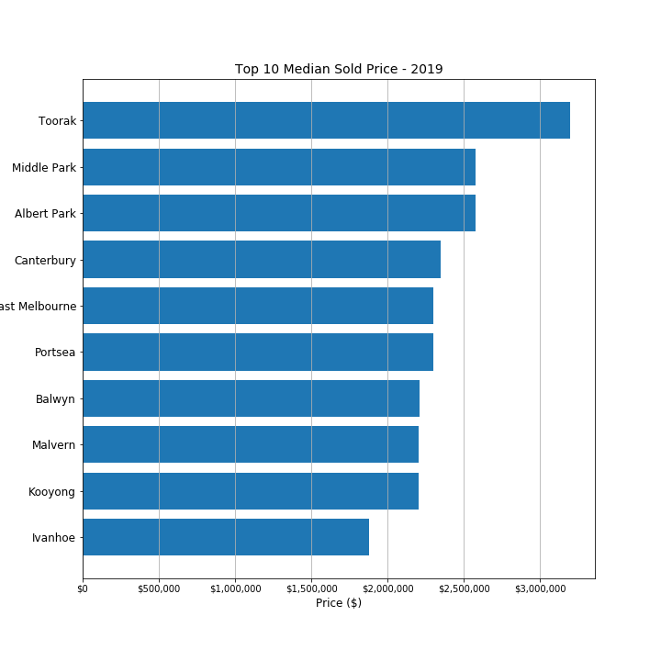
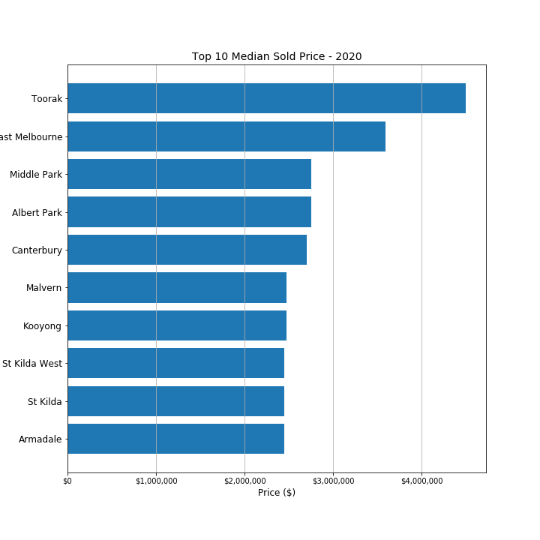
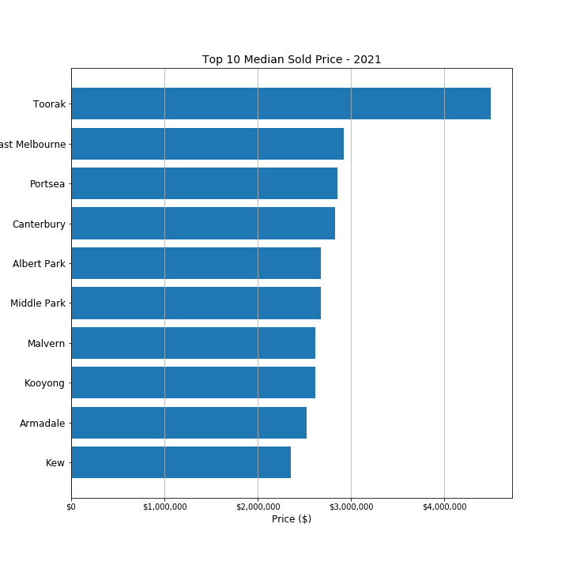
Toorak, St Kilda, East Melbourne, Canterbury, Kooyong, Malvern, Albert Part are very stable suburbs in Melbourne. Although the highest sold price list are changing, these 7 areas’ rent is very stable compare with others, but because there is very little mobility in those areas, and also take Covid into consideration, the mobility is even less.

Slide 12
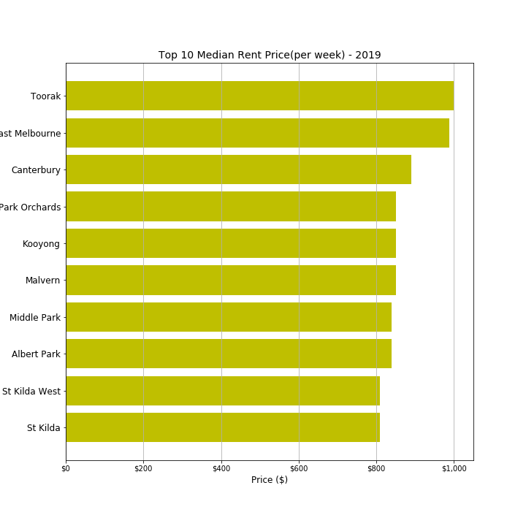
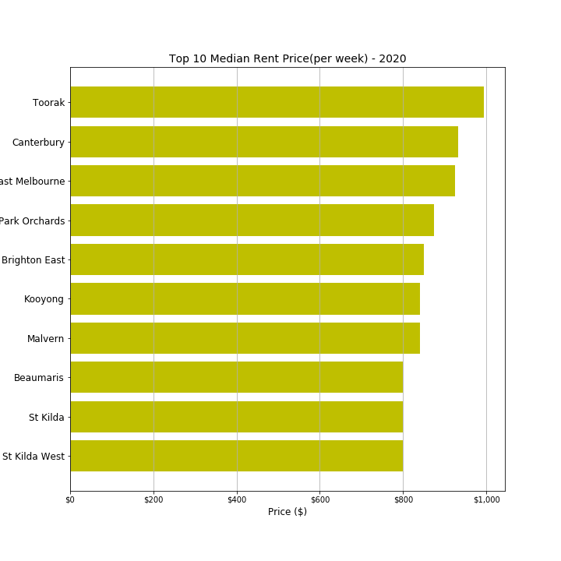
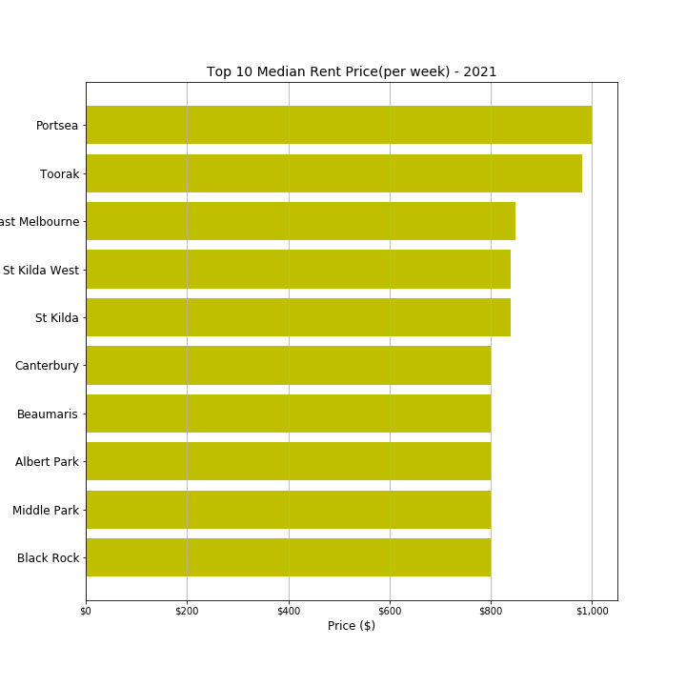
Toorak，St kilda, East melbourne, Canterbury, Kooyong, Malvern, Albert part

Slide 13
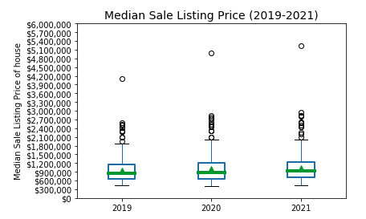
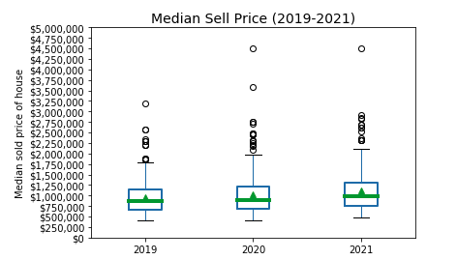
Two facts are clear if we look at the data on specialized issues:
1. In terms of Melbourne housing prices, there are too many outliers reflecting high prices. The median line is almost around 900K.
2. Both the listing price and the actual sell price are in a state of continuous rise, which is contrary to our feelings during 2019 - 2021.

Slide 14
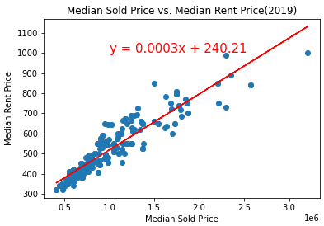
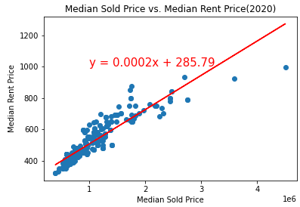
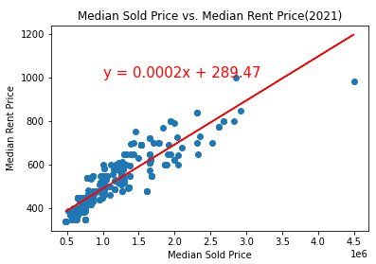
The correlation between Median Sold Price and Median Rent Price is 0.92, 0.91 and 0.89 for 2019,2020 and 2021 respectively. Indicates a strong positive correlation.

Slide 15
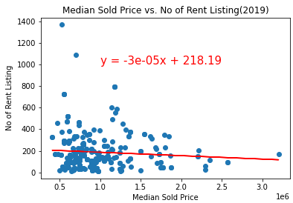
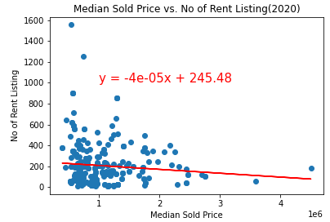
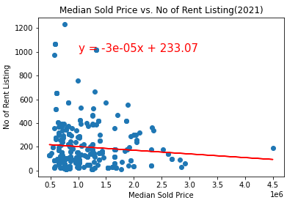
The correlation between Median Sold Price and No of Rent listing is -0.08,-0.09 and -0.08 for 2019,2020 and 2021 respectively. Indicates a weak negative correlation.

Slide 16
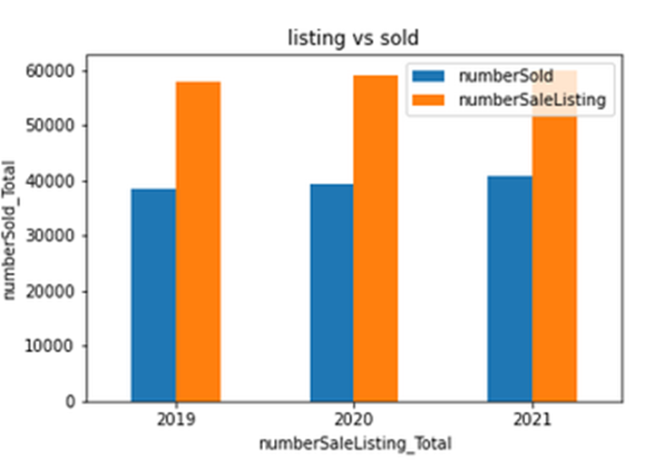
Comparison list vs sold for 2019, 2020 & 2021
Number listed has far out weight the number sold
In saying that the number listed and sold have only increased marginally
Covid hasn’t really had an impact in number of sales as covid started late 2019 into 2020
While cash rate peaked in 2019 and decreased 2020 to 2021. The sold price increased and rent price spiked in April and has now stayed consistent but have showed not major impact on sold and listed. Analysis of the quarterly data my reveal more insights

Slide 17
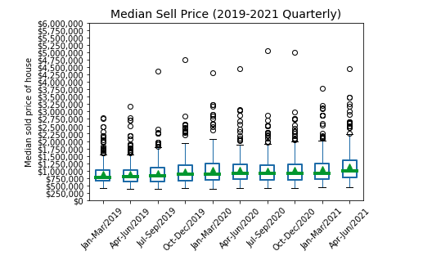
When we look more closely at quarterly data, we can still see that there was a drop in housing prices in Apr-Jun 2020, especially when we look at the highest IQR.

Slide 18
Covid-19 Impact

Slide 19
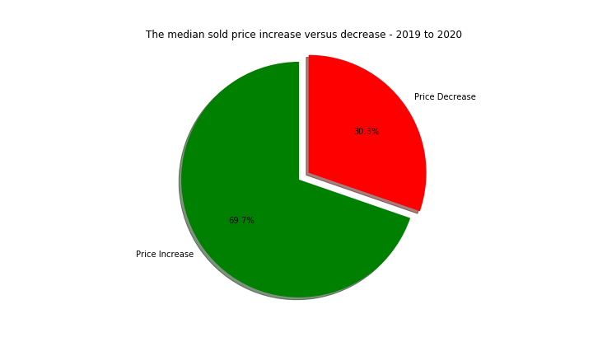
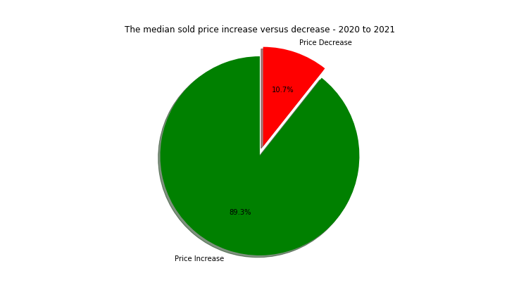
When we find out what percentage of properties have gone up in value compared to the previous year, we'll have a much clearer picture. In 2019-2020, 30% of property prices is reduced, but the next year that's down to 10%.
Although in 2020-2021，89% of the property price increases, the biggest increase value in 2019-2020 is $12,000,000, but by the 2020-2021, the number dropped to 600,000, The price difference is terrible.

Slide 20
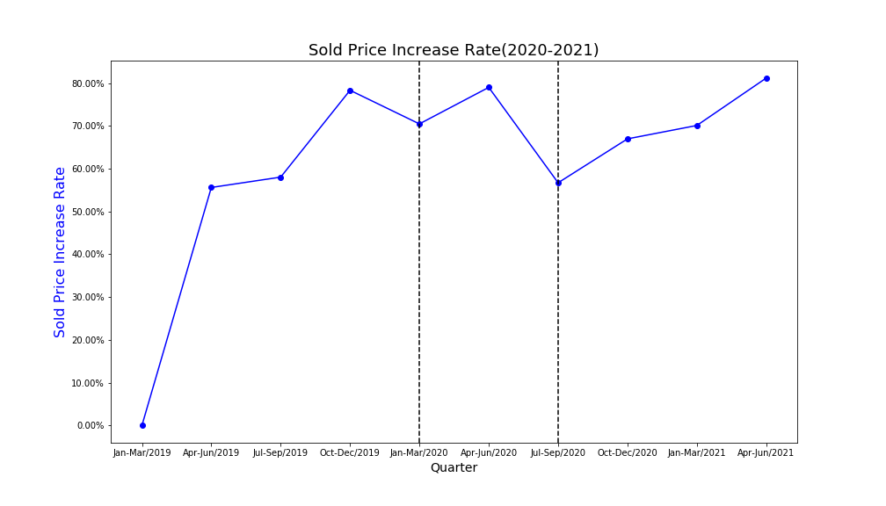
JJan-Mar 2020: COVID-19 has just begun to have an impact on Australia. Housing prices were affected three months later and the growth rate dropped.
JJul-Sep 2020: This period is the first time that Melbourne has entered lockdown, and the rate of housing price growth has decreased considerably.

Slide 21
Bank Interests Impact

Slide 22
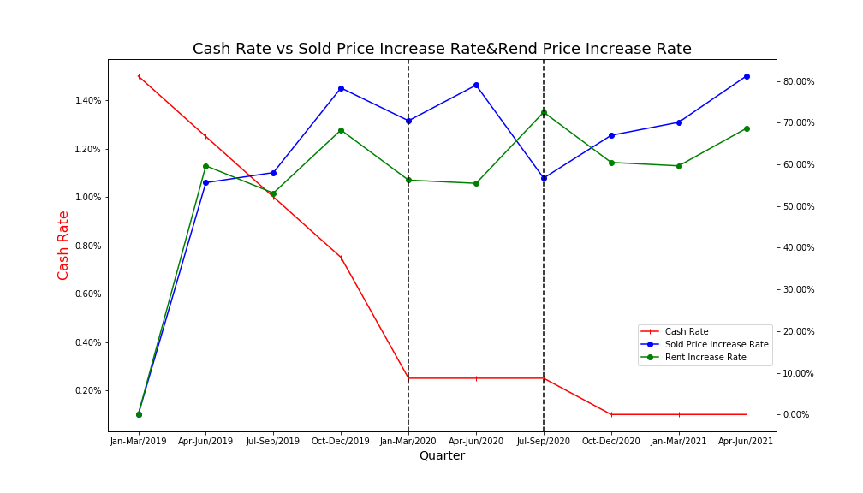
1. In the first quarter and the third quarter of 2020, the bank interests came to the lowest of the history, 0.25% and 0.1%, respectively. We can see that the housing price affected by COVID had a significant rise in the last quarter of these two periods.
2. The rental market has a relatively different reaction, although it is the same as sold price most of the time, but during the lockdown period, people prefer to rent, which leads to the increase.

Slide 23
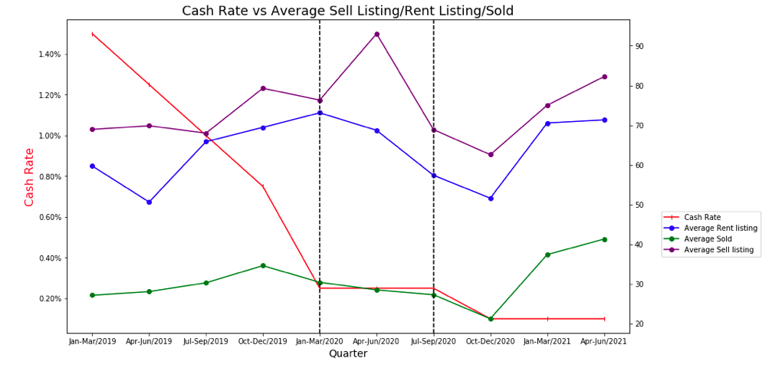
1. In the second quarter of 2020, many people began to put the houses they wanted to sell into the housing market, fearing the sharp decline of the housing price. However, the number of houses sold during this period was still declining.
2. The number of rentals basically does not change much, and it still follows the trend of median sold price.
3. The average number of actual sold properties increased by 100% after changing the bank interests to 0.1%.

Slide 24
School Locations and Ranking Impact

Slide 25
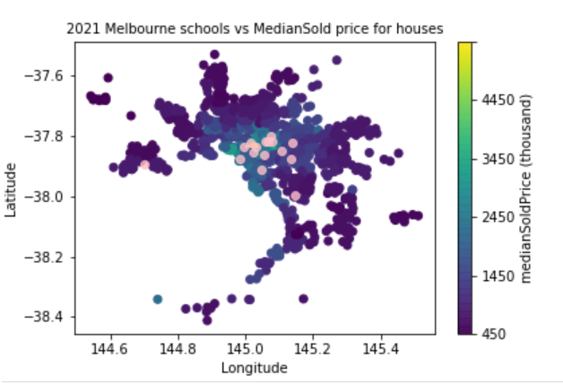
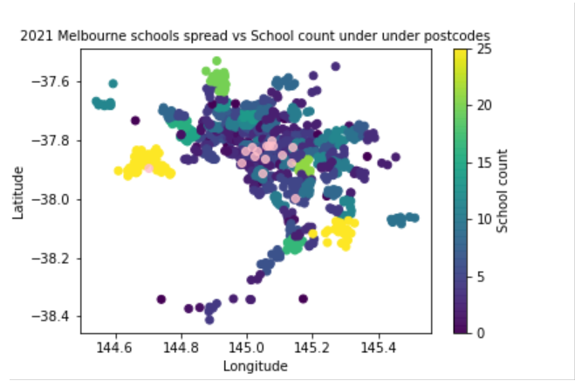
School Locations and Ranking
vs Median sold price for houses
Findings: there is correlation between schools’ ranking and the property sale price. Where there are high ranking schools, the property sale price appears to be higher
School Locations and Ranking
vs School count under postcodes
Findings: the numbers of schools in a suburb does not appear to have a positive impact on suburbs, we can see from the plot, where there are the most schools, the suburbs have rather low median sale price.

Slide 26
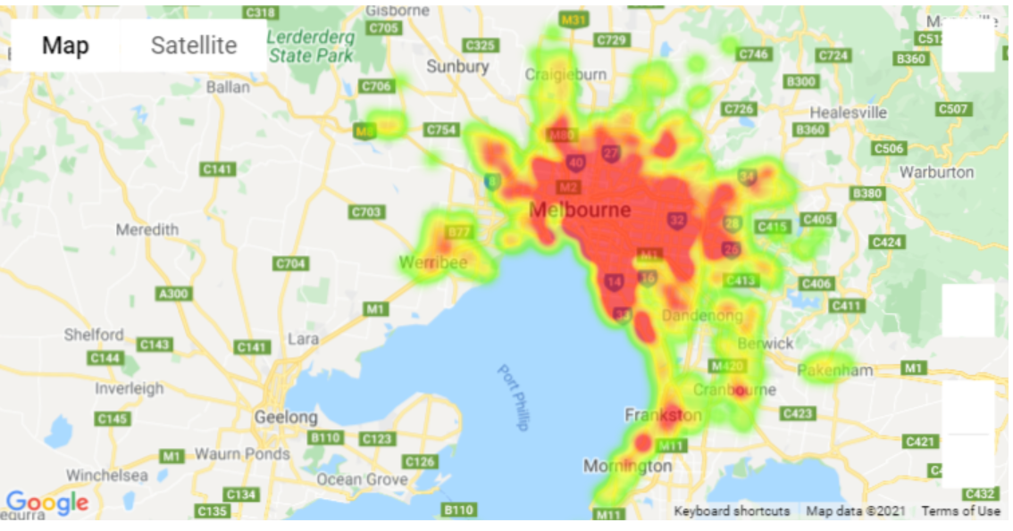
School Locations vs Median sold price for houses
The heatmap indicates how the sale price spread across the greater Melbourne region. Center of melbourne houses appears to be sold higher than surrounding suburbs

Slide 27
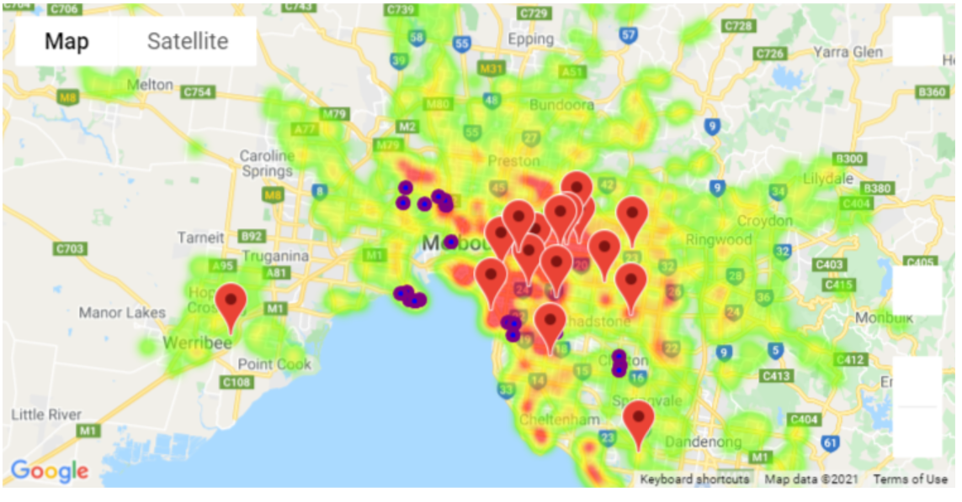
Most active houses selling suburbs & Top ranking schools
The symbol layer indicates the suburbs appear to have most sold properties. the makers flag the top ranking schools.
Findings : we can see there is not much overlapping between the suburbs has most sale activities and the suburbs has highest ranking schools.Saying that, it might also due to the fact that majorities of top ranking schools are located in the area that too expensive to purchase, and people opt to rent instead

Slide 28
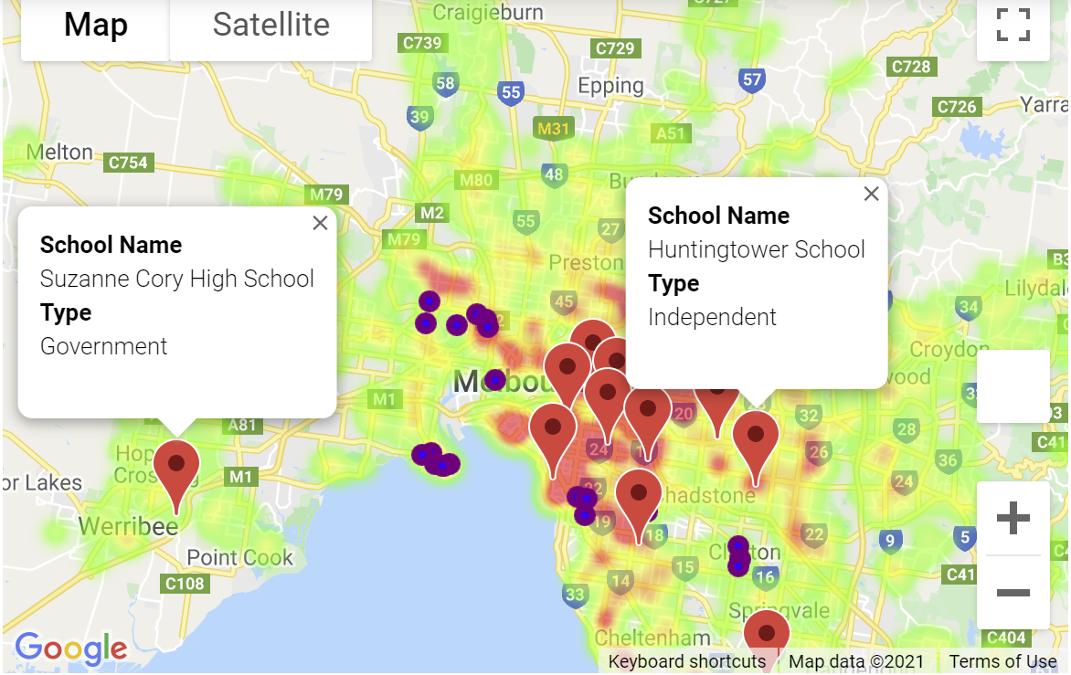
Most active houses selling suburbs & Top ranking schools
---there are some outliers, and the findings are limited based on the data source .To be able to have a better understanding how the property market works, we need to analyse further and combine other factors as well.

Slide 29
Discussion

Slide 30
Does Covid-19 has impact on real estate industry?
Yes, the entire housing market affected by COVID, with a sharp drop in housing prices.
Dose Bank Interests has impact on real estate industry?
Yes, the downsizing of Bank interests will definitely stimulate more people to buy houses, and the house price will rise to a certain extent, and more people will be willing to sell houses.
Do School numbers and ranking have impact on real estate industry?
Yes, those suburbs with higher ranking schools appear to have higher property price, but those suburb have most of schools does not show positive impact on the property price.

Slide 31
Post Mortem

Slide 32

Difficulties
The raw data is hard to acquire, use different API access
How to use a huge amount of data to answers the questions we have
The heatmap of suburbs can’t come up well because the shapefile reference index are different from different data sources, to align these index become very difficult

Slide 33

Further research
Further data before 2019 will be required to study the impact of COVID on real estate industry.
Utilise the monthly data to see whether the charts have any changes.
Look for source that provide greater melbourne suburbs shapefile to generate choropleth map.
The timepoints of the announcement of stamp duty reduce and other policies.

Slide 34
Thank you for watching!

Slide 35
Q&A Time

